Slide 1
COURSE CODE COURSE TITLE L T P J C
CSI3007 Advanced Python Programming 2 0 4 0 4
Module 4 Data Processing

Slide 2
Module 4: Data Processing
Objective: To perform advanced Data Preprocessing tasks like Data Merging and Munging (wrangling)
Outcome: Appreciate the difference between different data processing techniques

Slide 3
Module 4: Data Processing
4.1 Handling CSV, Excel and JSON data
4.2 Creating NumPyarrays, Indexing and slicing in NumPy
4.3 Downloading and parsing data
4.4 Creating multidimensional arrays
4.5 NumPyData types
4.6 Array Attribute
4.7 Indexing and Slicing
4.8 Creating Array views copies
4.9 Manipulating array shapes I/O
4.10 MATPLOT LIB

Slide 4
Data Processing
Data processing consists of gathering and manipulating data elements to return useful, potentially valuable information.
Different encoding types will have various processing formats. The most common formats for encodings are XML, CSV, JSON and HTML.
Why is data processing essential?
  Data processing is a vital part of data science. Having inaccurate and bad-quality data can be damaging to processes and analysis
  Good clean data will boost productivity and provide great quality information for decision-making

Slide 5
Data Processing …
Data processing starts with raw data and this raw data must be stored in some format before it can be cleaned, transformed, and analyzed.
To enable easy sharing and usage, data is commonly stored in standard file formats.
  CSV provides a simple way to store tabular data in plain text.
  Excel allows not just tables but also formulas, multiple sheets, and formatting, making it popular in businesses.
  JSON is designed for structured and hierarchical data, commonly used in web applications and APIs.
Without these formats, raw data would remain unstructured and difficult to process.
By storing data in structured format, we create a foundation that makes data processing efficient, reusable, and shareable.
9/4/2026

Slide 6
NumPy
NumPy was created in 2005 by Travis Oliphant and it is an open source project
NumPy stands for Numerical Python.
NumPy is a Python library used for working with arrays
Has functions for working with linear algebra, fourier transform, and matrices
Why use NumPy?
Python supports lists to serve the purpose of arrays, but they are slow to process
NumPy aims to provide an array object that is up to 50x faster than Python lists.
The array object in NumPy is called ndarray and it provides supporting functions to work with ndarray
Arrays are very frequently used structure in data science, where speed and resources are very important.
9/4/2026

Slide 7
Why is NumPy Faster Than Lists?
NumPy arrays are stored at one continuous place in memory unlike lists, so processes can access and manipulate them very efficiently. This behavior is called locality of reference in computer science.
This is the main reason why NumPy is faster than lists. Also it is optimized to work with latest CPU architectures.
Once NumPy is installed, import it in your applications by adding the import keyword:
    import numpy
    import numpy as np
    from numpy import *
9/4/2026

Slide 8
Pandas for Data Processing
Pandas is a Python library used for working with data sets
Provide functions for analyzing, cleaning, exploring and manipulating data
Pandas allows us to analyze big data and make conclusions based on statistical theories.
Pandas can clean messy data sets, and make them readable and relevant
The name "Pandas“ has a reference to both "PanelData“ (refers to multidimensional structured data), and "Python Data Analysis“ and was created by Wes McKinney in 2008.
9/4/2026

Slide 9
Handling CSV file
CSV is a file format you will frequently come across while working in the field of Data Science.
It is a type of text file that stores tabular data for better readability, easier understanding, and faster processing.
data scientists mostly rely on CSV data
Python has a built-in csv library that makes it easy to read data from CSV files and also write into them.
9/4/2026

Slide 10
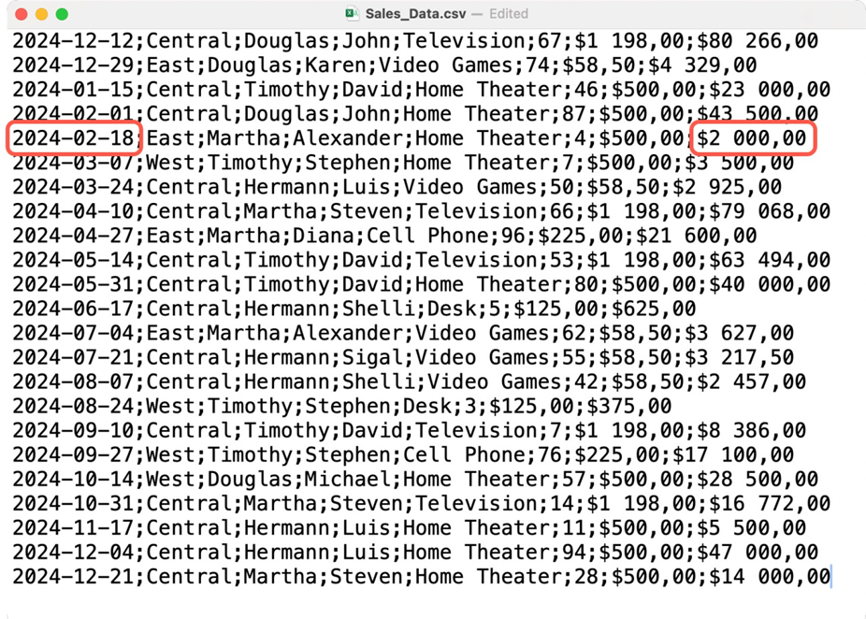
What is CSV ?
CSV stands for “Comma Separated Values.”
Example for CSV file:
9/4/2026

Slide 11
Handling CSV Files
csv.writer() → write rows (single or multiple)
csv.DictWriter() → write using dictionaries (key-value)
csv.reader() → read CSV row by row
Append mode ('a') → add new rows to existing file
9/4/2026

Slide 12
Writing Data with csv.writer()
The csv.writer() class allows writing data to a CSV file.
csv.writer(file, delimiter=',')
Always open the file with newline='' to avoid extra blank lines
writerow() → writes a single row
writerows() → writes multiple rows
9/4/2026

Slide 13
Writing Data with csv.writer()
import csv
# Sample data
data = [
["Name", "Age", "Parents Income"],
["Arun", 21, “5L”],
["Priya", 22, “9.2L”],
["Kiran", 20, “7.5L”]
]
# Writing CSV file
with open("students.csv", "w", newline="") as file:
writer = csv.writer(file)
writer.writerows(data)
print("CSV file created successfully!")
To print the location of the file:
import os
absolute_path = os.path.abspath("students.csv")
print(f"The absolute path of '{"students.csv"}' is: {absolute_path}")
9/4/2026

Slide 14
Writing Data with csv.writer()
Sample Program: Writing rows one by one
import csv
with open('profiles1.csv', 'w', newline='') as file:
writer = csv.writer(file)
field = ["name", "age", "country"]
writer.writerow(field) # writing header
writer.writerow(["Oladele Damilola", "40", "Nigeria"])
writer.writerow(["Alina Hricko", "23", "Ukraine"])
writer.writerow(["Isabel Walter", "50", "United Kingdom"])
9/4/2026

Slide 15
Writing Multiple Rows with writerows()
import csv
with open('profiles2.csv', 'w', newline='') as file:
writer = csv.writer(file)
row_list = [
["name", "age", "country"],
["Oladele Damilola", "40", "Nigeria"],
["Alina Hricko", "23", "Ukraine"],
["Isabel Walter", "50", "United Kingdom"]
]
writer.writerows(row_list) # writes all rows at once
9/4/2026

Slide 16
Writing Data with csv.DictWriter()
import csv
mydict = [
{'name': 'Kelvin Gates', 'age': '19', 'country': 'USA'},
{'name': 'Blessing Iroko', 'age': '25', 'country': 'Nigeria'},
{'name': 'Idong Essien', 'age': '42', 'country': 'Ghana'}
]
fields = ['name', 'age', 'country']
with open('profiles3.csv', 'w', newline='') as file:
writer = csv.DictWriter(file, fieldnames=fields)
writer.writeheader() # write column headers
writer.writerows(mydict) # write all rows
Instead of lists, we can use dictionaries.
Keys = column names (fieldnames)
Values = row data
9/4/2026

Slide 17
Handling CSV Files - Reading CSV Files
Using csv.reader()
import csv
def readcsv():
with open('profiles2.csv', newline='') as csv_file:
csv_read = csv.reader(csv_file, delimiter=',')
for row in csv_read:
print(row)
readcsv()
Output:
['name', 'age', 'country']
['Oladele Damilola', '40', 'Nigeria']
['Alina Hricko', '23', 'Ukraine']
['Isabel Walter', '50', 'United Kingdom']
9/4/2026

Slide 18
Handling CSV Files - Appending Data to CSV
We can add new rows to an existing CSV file by opening it in append mode ('a').
from csv import writer
# New row to add
new_row = [6, 'William', 5532, 1, 'UAE']
# Append to CSV file
with open('event.csv', 'a', newline='') as f_object:
writer_object = writer(f_object)
writer_object.writerow(new_row)
print("Row appended successfully!")
9/4/2026

Slide 19
Handling CSV Files – Sample Programs
import csv
# Step 1: Writing CSV using writer and writerow()
with open('profiles1.csv', 'w', newline='') as file:
writer = csv.writer(file, delimiter=',')
# Writing header
field = ["name", "age", "country"]
writer.writerow(field)
# Writing rows
writer.writerow(["Oladele Damilola", "40", "Nigeria"])
writer.writerow(["Alina Hricko", "23", "Ukraine"])
writer.writerow(["Isabel Walter", "50", "United Kingdom"])
# Step 2: Writing multiple rows using writerows()
with open('profiles2.csv', 'w', newline='') as file:
writer = csv.writer(file, delimiter=',')
row_list = [
["name", "age", "country"],
["Oladele Damilola", "40", "Nigeria"],
["Alina Hricko", "23", "Ukraine"],
["Isabel Walter", "50", "United Kingdom"]
]
writer.writerows(row_list)
9/4/2026

Slide 20
Sample Programs – Cont..
# Step 3: Writing CSV using DictWriter
mydict = [
{'name': 'Kelvin Gates', 'age': '19', 'country': 'USA'},
{'name': 'Blessing Iroko', 'age': '25', 'country': 'Nigeria'},
{'name': 'Idong Essien', 'age': '42', 'country': 'Ghana'}
]
fields = ['name', 'age', 'country']
with open('profiles3.csv', 'w', newline='') as file:
writer = csv.DictWriter(file, fieldnames=fields, delimiter=',')
writer.writeheader() # writing header
writer.writerows(mydict)
# Step 4: Reading CSV using csv.reader()
print("Reading profiles1.csv before append:")
with open('profiles1.csv', newline='') as file:
csv_read = csv.reader(file, delimiter=',')
for row in csv_read:
print(row)
9/4/2026

Slide 21
Sample Programs – Cont..
# Step 5: Appending data to existing CSV
new_row = ["William", "28", "UAE"]
with open('profiles1.csv', 'a', newline='') as file:
writer = csv.writer(file, delimiter=',')
writer.writerow(new_row)
# Step 6: Show file after append
print("\nReading profiles1.csv after append:")
with open('profiles1.csv', newline='') as file:
csv_read = csv.reader(file, delimiter=',')
for row in csv_read:
print(row)
9/4/2026

Slide 22
Limitation of CSV
Python’s built-in csv module allows you to read, write, and append CSV files.
Works for simple CSV operations, but:
    Needs manual handling of headers, data types, and missing values.
    Limited capabilities for data analysis or manipulation.
As datasets grow larger and more complex, we need:
    Easy reading/writing for multiple file formats (CSV, Excel, JSON).
    Efficient handling of tabular data (filtering, slicing, aggregating)
    Integration with NumPy and visualization tools for analysis
9/4/2026

Slide 23
Pandas …
Pandas is designed to overcome these limitations.
Pandas is an open-source Python library used for data manipulation, analysis, and cleaning.
Provides high-performance data structures and tools for working with structured data like tables, spreadsheets, CSV files, Excel, and SQL databases.
It can read/write CSV files like the csv module, but:
      Automatically handles headers, indexes, and missing values.
      Loads data into a DataFrame, a powerful 2D table-like structure.
      Provides easy manipulation, filtering, aggregation, and plotting.
import pandas as pd
df = pd.read_csv("students.csv")
print(df.head())
9/4/2026

Slide 24
Handling CSV Files using Pandas
import pandas as pd
# 1. Creating and Writing CSV
data = {
"Name": ["Arun", "Priya", "Kiran"],
"Age": [21, 22, 20],
"Marks": [85, 90, 78]
}
# Create DataFrame
df = pd.DataFrame(data)
# Write to CSV
df.to_csv("students.csv", index=False)
print("CSV file 'students.csv' created successfully \n")
# ---------------------------
# 2. Reading CSV
print("Reading 'students.csv':")
df_read = pd.read_csv("students.csv")
print(df_read, "\n")
# 3. Appending Data to CSV
# ---------------------------
# New data row
new_row = {"Name": "William", "Age": 28, "Marks": 92}
# Append new row
df_updated = pd.concat([df_read, pd.DataFrame([new_row])], ignore_index=True)
# Save updated CSV
df_updated.to_csv("students.csv", index=False)
print("New row appended to 'students.csv' \n")
# 4. Reading Updated CSV
print("Reading updated 'students.csv':")
df_final = pd.read_csv("students.csv")
print(df_final)
ignore_index=True will create a new default integer index for the resulting DataFrame, starting from 0.
index=False prevents writing row numbers into the file
9/4/2026

Slide 25
Handling JSON Data
JSON - JavaScript Object Notation
JSON files are lightweight and human readable to store and exchange data
Primarily used for storing and transferring data between the browser and the server
It is easy for machines to parse and generate these files and are based on the JavaScript programming language
JSON files store data within { } similar to how a dictionary stores it in Python
9/4/2026

Slide 26
Handling JSON Data
Major benefit: language independent and can be used with any programming language such as Python, C or Java!
Python too supports JSON with a built in package called json
This package provides all the necessary tools for working with JSON Objects including parsing, serializing, deserializing and many more
For example: to convert the JSON objects to Python objects and vice versa
9/4/2026

Slide 27
Handling JSON Data
json.dump() → Write dictionary to JSON file
json.load() → Read JSON from a file
json.dumps() → Convert dictionary to JSON string
json.loads() → Convert JSON string to Python object
9/4/2026

Slide 28
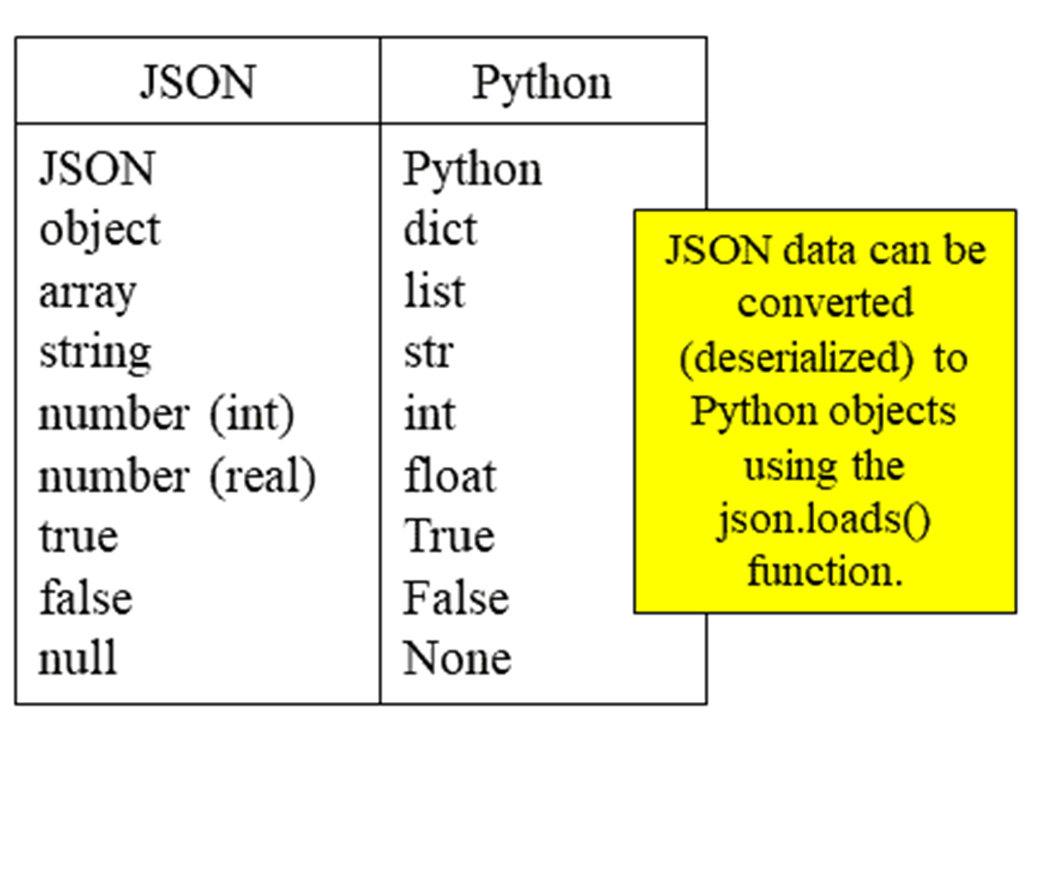
Handling JSON Data
Mapping JSON to Python Objects:
When working with JSON, data types map directly to Python objects.
9/4/2026

Slide 29
Reading JSON from a File
import json
with open('person.json', 'r') as f:
data = json.load(f)
print(data) # {'name': 'Bob', 'languages': ['English', 'French']}
9/4/2026

Slide 30
Serialization (Python Object → JSON)
Serialization means converting Python objects into JSON format.
a) json.dump()
Writes Python objects to a JSON file.
"emp2": {
"name": "Elis",
"designation": "Trainee",
"age": "24",
"salary": "40000"
}
}
# Save dictionary as JSON file
out_file = open("myfile.json", "w")
json.dump(dict1, out_file, indent=6)
out_file.close()
import json
# Python dictionary
dict1 = {
"emp1": {
"name": "Lisa",
"designation": "Programmer",
"age": "34",
"salary": "54000"
},
9/4/2026

Slide 31
Serialization (Python Object → JSON)
b) json.dumps()
Converts a Python object into a JSON string.
import json
person_dict = {
'name': 'Bob',
'age': 12,
'children': None
}
# Convert dict to JSON string
person_json = json.dumps(person_dict)
print(person_json) # {"name": "Bob", "age": 12, "children": null}
9/4/2026

Slide 32
Deserialization (JSON → Python Object)
import json
# Opening JSON file
f = open('data.json')
# Load JSON data into Python dict
data = json.load(f)
# Iterating through JSON
for i in data['emp_details']:
print(i)
f.close()
Deserialization means converting JSON data into Python objects.
a) json.load()
Reads JSON data from a file and returns a Python object.
9/4/2026

Slide 33
Deserialization (JSON → Python Object)
import json
# JSON string
person = '{"name": "Bob", "languages": ["English", "French"]}'
# Convert string to Python dictionary
person_dict = json.loads(person)
print(person_dict)
# {'name': 'Bob', 'languages': ['English', 'French']}
print(person_dict['languages'])
# ['English', 'French']
b) json.loads()
Reads JSON data from a string and converts it into a Python object.
9/4/2026

Slide 34
JSON – Sample Program
import json
# 1. dump() → Write Python dict to JSON file
# ---------------------------
employee_data = {
"emp1": {"name": "Alice", "age": 30, "department": "HR"},
"emp2": {"name": "Bob", "age": 25, "department": "IT"}
}
with open("employees.json", "w") as f:
json.dump(employee_data, f, indent=4) # save with pretty-print
print("employees.json created using dump() ")
# 2. load() → Read JSON file into Python dict
# ---------------------------
with open("employees.json", "r") as f:
data_from_file = json.load(f)
print("\nReading JSON file with load():")
print(data_from_file)
# 3. dumps() → Convert Python dict to JSON string
# ---------------------------
person_dict = {"name": "Charlie", "age": 35, "skills": ["Python", "AI"]}
person_json = json.dumps(person_dict, indent=4)
print("\nConverting Python dict to JSON string with dumps():")
print(person_json)
# 4. loads() → Convert JSON string to Python dict
# ---------------------------
json_string = '{"city": "New York", "population": 890000, "famous": true}'
city_dict = json.loads(json_string)
print("\nConverting JSON string to Python dict with loads():")
print(city_dict)
print("City Name:", city_dict["city"])

Slide 35
Handling JSON USING PANDAS
# 3. Inspecting Data
# -----------------------------
print("\n=== Head of DataFrame ===")
print(df.head())
print("\n=== DataFrame Info ===")
print(df.info())
print("\n=== Statistical Summary ===")
print(df.describe(include="all"))
# -----------------------------
# 4. Selecting Columns & Rows
print("\n=== Selecting 'name' column ===")
print(df["name"])
print("\n=== Selecting first 2 rows ===")
print(df.iloc[0:2])
# 5. Filtering Data
filtered_df = df[df["age"] > 28]
print("\n=== People older than 28 ===")
print(filtered_df)
import pandas as pd
# 1. Create sample JSON data (normally you'd load from file)
# -----------------------------
data = [
{"id": 1, "name": "Alice", "age": 25, "city": "New York"},
{"id": 2, "name": "Bob", "age": 30, "city": "Los Angeles"},
{"id": 3, "name": "Charlie", "age": 35, "city": "Chicago"},
{"id": 4, "name": "Diana", "age": 28, "city": "San Francisco"}
]
df = pd.DataFrame(data)
df.to_json("people.json", orient="records", indent=4)
print("=== JSON file created: people.json ===")
print(df)
# -----------------------------
# 2. Reading JSON file
df = pd.read_json("people.json")
print("\n=== After Reading JSON ===")
print(df)
9/4/2026

Slide 36
Handling JSON USING PANDAS
# 6. Adding a New Column
# -----------------------------
df["age_group"] = df["age"].apply(lambda x: "Young" if x < 30 else "Old")
print("\n=== After Adding 'age_group' Column ===")
print(df)
# -----------------------------
# 7. Updating Values
df.loc[df["name"] == "Alice", "city"] = "Boston"
print("\n=== After Updating Alice's City ===")
print(df)
# -----------------------------
# 8. Writing JSON back
df.to_json("people_updated.json", orient="records", indent=4)
print("\n=== Final DataFrame written to people_updated.json ===")
print(df)
9/4/2026

Slide 37
Handling Excel File in Python
Automate Excel workflows using Python:
  Spreadsheet consolidation
  Data cleaning
  Predictive modeling
Python scripts can reduce repetitive manual work to minutes instead of hours.
Python can also schedule scripts to run automatically, reducing human intervention.
9/4/2026

Slide 38
Handling Excel File in Python
Openpyxl is a Python library for reading, writing, and manipulating Excel files (.xlsx).
Key features:
  Write functions, formulas, and reports directly in Python.
  Format cells and worksheets (colors, styles, fonts).
  Create charts and visualizations and save them to Excel.
  Iterate through worksheets to apply the same analysis on multiple datasets.
Automation: Perform an operation once and replicate it across multiple worksheets efficiently.
          Installing Openpyxl: pip install openpyxl
9/4/2026

Slide 39
What You Can Do with Openpyxl?
Read and Write Excel Files
  Open existing spreadsheets or create new ones.
Arithmetic Operations and Formulas
  Write formulas and calculations directly in Excel cells.
Manipulate Worksheets
  Add, delete, rename, and iterate through worksheets.
Build Visualizations
  Create charts in Python and embed them into Excel files.
Format Cells
  Change cell colors, fonts, borders, and styles.
9/4/2026

Slide 40
Reading Excel Files in Python with Openpyxl
1. Loading the Workbook
To begin, import the Openpyxl library and load the Excel workbook into Python:
import openpyxl
# Load the Excel file
wb = openpyxl.load_workbook('videogamesales.xlsx')
2. Accessing Worksheets
Once the workbook is loaded, we need to specify which worksheet to work with.
There are two ways to do this: The first method is to simply call the active worksheet, which is the first sheet in the workbook.
ws = wb.active
9/4/2026

Slide 41
Reading Excel Files in Python with Openpyxl
Alternatively, if you know the name of the worksheet, you can also access it by its name.
ws = wb['vgsales']
3. Count the number of rows and columns in this worksheet.
print('Total number of rows: '+str(ws.max_row))
print('Total number of columns: '+str(ws.max_column))
4. Reading Data From a Cell
print('The value in cell A1 is: '+ws['A1'].value)
5. Reading Data From Multiple Cells
values = [ws.cell(row=1,column=i).value for i in range(1,ws.max_column+1)]
print(values)
9/4/2026

Slide 42
Reading Excel Files in Python with Openpyxl
6. printing out multiple rows in a specific column
data=[ws.cell(row=i,column=2).value for i in range(2,12)]
print(data)
9/4/2026

Slide 43
Writing to Excel Files with Openpyxl
Creating to a Cell/Column
By accessing the cell directly using its key:
ws['K1'] = 'Sum of Sales‘
By specifying the row and column position of the cell:
ws.cell(row=1, column=11, value = 'Sum of Sales')
Every time you write to an Excel file with Openpyxl, you need to save your changes.
wb.save('videogamesales.xlsx')
9/4/2026

Slide 44
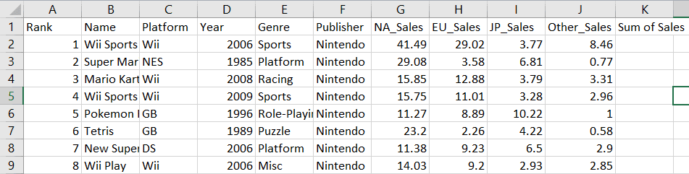
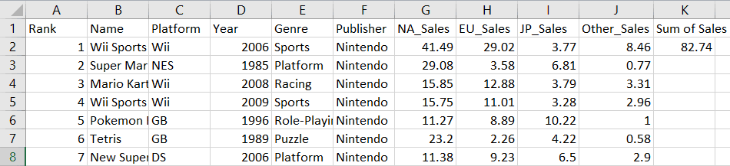
Writing to Excel Files with Openpyxl
Writing a New Cell/Column
  row_position = 2
  col_position = 7
  total_sales = ((ws.cell(row=row_position, column=col_position).value)+ (ws.cell(row=row_position, column=col_position+1).value) +
  (ws.cell(row=row_position, column=col_position+2).value) +
  (ws.cell(row=row_position, column=col_position+3).value)) ws.cell(row=2,column=11).value=total_sales
  wb.save('videogamesales.xlsx')
9/4/2026

Slide 45
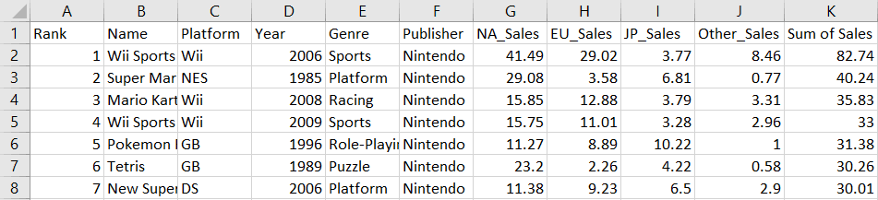
Writing to Excel Files with Openpyxl
create a for loop to sum the sales values in every row:
row_position = 1
for i in range(1, ws.max_row):
    row_position += 1
    NA_Sales = ws.cell(row=row_position, column=7).value
    EU_Sales = ws.cell(row=row_position, column=8).value
    JP_Sales = ws.cell(row=row_position, column=9).value
    Other_Sales = ws.cell(row=row_position, column=10).value
    total_sales = (NA_Sales + EU_Sales + JP_Sales + Other_Sales)
    ws.cell(row=row_position, column=11).value = total_sales
wb.save("videogamesales.xlsx")
9/4/2026

Slide 46
Creating Excel Formulas with Openpyxl
AVERAGE: create a new column called “Average Sales” to calculate the average total video game sales
ws['P1'] = 'Average Sales'
ws['P2'] = '= AVERAGE(K2:K16220)'
wb.save('videogamesales.xlsx')
COUNTIF: counts the number of cells that meet a specific condition
ws['R1'] = 'Number of Rows with Sports Genre'
ws['R2'] = '=COUNTIF(E2:E16220, "Sports")'
wb.save('videogamesales.xlsx')
SUMIF: find the total “Sum of Sales” generated by sports games
ws['S1'] = 'Total Sports Sales'
ws['S2'] = '=SUMIF(E2:E16220, "Sports",K2:K16220)'
wb.save('videogamesales.xlsx')
CEILING: rounds a number up to the nearest specified multiple
ws['T1'] = 'Rounded Sum of Sports Sales'
ws['T2'] = '=CEILING(S2,25)‘
wb.save('videogamesales.xlsx')
9/4/2026

Slide 47
Working with Sheets in Openpyxl
Changing Sheet Names
print(ws.title)
ws.title ='Video Game Sales Data'
wb.save('videogamesales.xlsx')
Deleting a Worksheet
wb.remove(wb['Empty Sheet'])
print(wb.sheetnames)
wb.save('videogamesales.xlsx')
Duplicating a Worksheet
wb.copy_worksheet(wb['Video Game Sales Data'])
wb.save('vgsales_2.xlsx')
9/4/2026

Slide 48
Adding Charts to an Excel File with Openpyxl
access this worksheet before we start creating the bar chart:
ws = wb['Total Sales by Genre'] # access the required worksheet
# Values for plotting
from openpyxl.chart import Reference
values = Reference(ws, # worksheet object
min_col=2, # minimum column where your values begin
max_col=2, # maximum column where your values end
min_row=1, # minimum row you’d like to plot from
max_row=13) # maximum row you’d like to plot from
set parameters for the chart’s categories:
cats = Reference(ws, min_col=1, max_col=1, min_row=2, max_row=13)
Creating the Bar Chart: create the bar chart object and include our values and categories
from openpyxl.chart import BarChart
chart = BarChart()
chart.add_data(values, titles_from_data=True)
chart.set_categories(cats)
9/4/2026

Slide 49
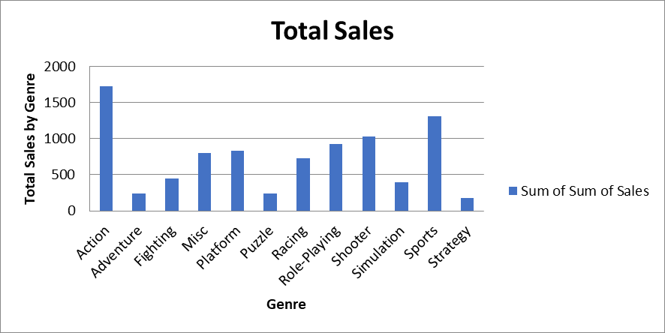
Cont …
Set Chart Titles:
  # set the title of the chart
  chart.title = "Total Sales"
  # set the title of the x-axis
  chart.x_axis.title = "Genre"
  # set the title of the y-axis
  chart.y_axis.title = "Total Sales by Genre"
  # the top-left corner of the chart
  # is anchored to cell F2 .
  ws.add_chart(chart,"D2")
  # save the file
  wb.save("videogamesales.xlsx")
9/4/2026

Slide 50
Handling EXcel USING PANDAS
import pandas as pd
# 1. Reading Excel File
df = pd.read_excel("sample.xlsx", sheet_name="Sheet1") # specify sheet
print("=== After Reading Excel File ===")
print(df)
# -----------------------------
# 2. Inspecting Data
print("\n=== Head of DataFrame ===")
print(df.head())
print("\n=== DataFrame Info ===")
print(df.info())
print("\n=== Statistical Summary ===")
print(df.describe(include="all"))
# -----------------------------
# 3. Selecting Columns & Rows
print("\n=== Selecting 'Name' column ===")
print(df["Name"])
print("\n=== Selecting first 3 rows ===")
print(df.iloc[0:3])
9/4/2026

Slide 51
Handling EXcel USING PANDAS
# 4. Filtering Data
filtered_df = df[df["Age"] > 25]
print("\n=== People older than 25 ===")
print(filtered_df)
# 5. Adding a New Column
df["Age_Group"] = df["Age"].apply(lambda x: "Young" if x < 30 else "Old")
print("\n=== After Adding 'Age_Group' Column ===")
print(df)
# 6. Updating Values
df.loc[df["Name"] == "Alice", "City"] = "Boston"
print("\n=== After Updating Alice's City ===")
print(df)
# 7. Writing Data Back to Excel
df.to_excel("sample_updated.xlsx", sheet_name="UpdatedData", index=False)
print("\n=== Final DataFrame written to sample_updated.xlsx ===")
print(df)
9/4/2026

Slide 52
NumPy
NumPy was created in 2005 by Travis Oliphant and it is an open source project
NumPy stands for Numerical Python.
NumPy is a Python library used for working with arrays
Has functions for working with linear algebra, fourier transform, and matrices
Why use NumPy?
Python supports lists to serve the purpose of arrays, but they are slow to process
NumPy aims to provide an array object that is up to 50x faster than Python lists.
The array object in NumPy is called ndarray and it provides supporting functions to work with ndarray
Arrays are very frequently used structure in data science, where speed and resources are very important.
9/4/2026

Slide 53
Why is NumPy Faster Than Lists?
NumPy arrays are stored at one continuous place in memory unlike lists, so processes can access and manipulate them very efficiently. This behavior is called locality of reference in computer science.
This is the main reason why NumPy is faster than lists. Also it is optimized to work with latest CPU architectures.
Once NumPy is installed, import it in your applications by adding the import keyword:
    import numpy
    import numpy as np
    from numpy import *
9/4/2026

Slide 54
Creating NumPy Arrays, Indexing and Slicing

Slide 55
What is NumPy?
NumPy is a Python library used for working with arrays.
NumPy stands for Numerical Python.
In Python we have lists that serve the purpose of arrays, but they are slow to process.
NumPy aims to provide an array object that is up to 50x faster than traditional Python lists.
The array object in NumPy is called ndarray, it provides a lot of supporting functions that make working with ndarray very easy.
Why is NumPy Faster Than Lists?
NumPy arrays are stored at one continuous place in memory unlike lists, so processes can access and manipulate them very efficiently.
This behavior is called locality of reference in computer science.
This is the main reason why NumPy is faster than lists. Also it is optimized to work with latest CPU architectures.

Slide 56
Creating array object
NumPy is used to work with arrays. The array object in NumPy is called ndarray.
We can create a NumPy ndarray object by using the array() function.
to create an ndarray, we can pass a list, tuple or any array-like object into the array() method.
Creating array from list
arr = np.array([1, 2, 3, 4, 5])
print(arr)
Output: [1 2 3 4 5]
Creating array from tuple
arr = np.array((1, 2, 3, 4, 5))
print(arr)
Output: [1 2 3 4 5]

Slide 57
Dimensions in Arrays
A dimension in arrays is one level of array depth (nested arrays).
nested array: are arrays that have arrays as their elements.
0-D array
Each value in an array is a 0-D array.
Create a 0-D array with value 42
  ar1 = np.array(42)
  Output: 42
1-D array
An array that has 0-D arrays as its elements is called uni-dimensional or 1-D array.
Create a 1-D array containing the values 1,2,3,4,5:
ar2 = np.array([1, 2, 3, 4, 5])
Output: [1 2 3 4 5]

Slide 58
Dimensions in Arrays
2-D Arrays
An array that has 1-D arrays as its elements is called a 2-D array. These are often used to represent matrix.
Create a 2-D array containing two arrays with the values 1,2,3 and 4,5,6:
ar3 = np.array([[1, 2, 3], [4, 5, 6]]) → 2-D array
Output: [[[1 2 3]
[4 5 6]]
3-D array
An array that has 2-D arrays (matrices) as its elements is called 3-D array.
Create a 3-D array with two 2-D arrays, both containing two arrays with the values 1,2,3 and 4,5,6:
ar4 = np.array([[[1, 2, 3], [4, 5, 6]], [[7,8,9], [10, 11, 12]]]) → 3-D array
Output: [[[1 2 3]
[4 5 6]]
[[7 8 9]
[10 11 12]]]

Slide 59
Basic array characteristics
# Creating array object
arr = np.array( [[ 1, 2, 3],[ 4, 2, 5]])
# Printing array dimensions (axes)
print("No. of dimensions: ", arr.ndim)
Output: No. of dimensions: 2
# Printing shape of array
print("Shape of array: ", arr.shape)
Output: Shape of array: (2, 3)
# Printing size (total number of elements) of array
print("Size of array: ", arr.size)
Output:
Output: Size of array: 6
# Printing type of elements in array
print("Array stores elements of type: ", arr.dtype)
Output: Array stores elements of type: int64

Slide 60
Array creation
There are various ways to create arrays in NumPy.
Creating a 3X4 array with all zeros
    c = np.zeros((3, 4))
    Output: An array initialized with all zeros:
    [[0. 0. 0. 0.]
    [0. 0. 0. 0.]
    [0. 0. 0. 0.]]
Creating a 3X4 array with all ones
c = np.ones((3, 4))
Output: An array initialized with all ones:
[[1. 1. 1. 1.]
[1. 1. 1. 1.]
[1. 1. 1. 1.]]
Create a constant value array
d = np.full((3, 3), 6)
Output:
An array initialized with all 6s.
[[6 6 6]
[6 6 6]
[6 6 6]]

Slide 61
Array creation
# Create an array with random values
e = np.random.random((2, 2))
Output:
A random array:
[[0.22372768 0.30317382]
[0.71317207 0.83086009]]
#Create a sequence of integers # from 0 to 30 with step
arange: returns evenly spaced values within a given interval. step size is specified.
f = np.arange(0, 30, 5)
Output: [ 0 5 10 15 20 25]

Slide 62
Array creation
#Create a sequence of 10 values in range 0 to 5
linspace: returns evenly spaced values within a given interval. num no. of elements are returned.
g = np.linspace(0, 5, 10)
Output:
[ 0. 0.55555556 1.11111111 1.66666667 2.22222222 2.77777778 3.33333333 3.88888889 4.44444444 5. ]
#Reshaping 3X4 array to 2X2X3 array
We can use reshape method to reshape an array.
arr = np.array([[1, 2, 3, 4], [5, 2, 4, 2], [1, 2, 0, 1]])
newarr = arr.reshape(2, 2, 3)
Output: Reshaped array:
[[[1 2 3] [4 5 2]]
[[4 2 1] [2 0 1]]]
Flatten array
Flatten array: We can use flatten method to get a copy of array collapsed into one dimension.
arr = np.array([[1, 2, 3], [4, 5, 6]])
flarr = arr.flatten()
Output:
Fattened array: [1 2 3 4 5 6]

Slide 63
Array Slicing
Array with first 2 rows and alternate columns(0 and 2): [[-1. 0.] [ 4. 6.]]
Just like lists in python, NumPy arrays can be sliced. As arrays can be multidimensional, you need to specify a slice for each dimension of the array.
Slicing in python means taking elements from one given index to another given index.
We pass slice instead of index like this: [start:end].
We can also define the step, like this: [start:end:step].
Slicing 1-D Arrays
arr = np.array([1, 2, 3, 4, 5, 6, 7])
print(arr[1:5])
print(arr[4:])
print(arr[:4])
print(arr[1:5:2])
print(arr[::2])
Slicing 2-D Arrays
arr = np.array([[1, 2, 3, 4, 5], [6, 7, 8, 9, 10]])
print(arr[1, 1:4]) → From the second element, slice elements from index 1 to index 4 (not included):
Output: [7 8 9]

Slide 64
Array Slicing
arr = np.array([[1, 2, 3, 4, 5], [6, 7, 8, 9, 10]])
print(arr[0:2, 2])→ From both elements, return index 2:
Output: [3 8]
arr = np.array([[1, 2, 3, 4, 5], [6, 7, 8, 9, 10]])
print(arr[0:2, 1:4])
Output: [[2 3 4]
[7 8 9]]
arr = np.array([[-1, 2, 0, 4],[4, -0.5, 6, 0],[2.6, 0, 7, 8],[3, -7, 4, 2.0]])
Print(arr[:2, ::2]) → Array with first 2 rows and alternate columns(0 and 2):
Output: [[-1. 0.]
[ 4. 6.]]

Slide 65
NumPy Array Indexing
Array indexing is the same as accessing an array element.
The indexes in NumPy arrays start with 0, meaning that the first element has index 0, and the second has index 1 etc.
Integer array indexing: In this method, lists are passed for indexing for each dimension. One to one mapping of corresponding elements is done to construct a new arbitrary array.
Access 1-D Arrays
arr = np.array([1, 2, 3, 4])
print(arr[0])
Output: 1
Access 2-D Arrays
To access elements from 2-D arrays we can use comma separated integers representing the dimension and the index of the element.
arr = np.array([[1,2,3,4,5], [6,7,8,9,10]])
print('2nd element on 1st row: ', arr[0, 1])
Output: 2nd element on 1st row: 2

Slide 66
NumPy Array Indexing
Get third and fourth elements from the following array and add them.
import numpy as np
arr = np.array([1, 2, 3, 4])
print(arr[2] + arr[3])
Output: ?
arr = np.array([[-1, 2, 0, 4],[4, -0.5, 6, 0],[2.6, 0, 7, 8],[3, -7, 4, 2.0]])
temp = arr[[0, 1, 2, 3], [3, 2, 1, 0]]
print ("\nElements at indices (0, 3), (1, 2), (2, 1),(3, 0):\n", temp)
Output: Elements at indices (0, 3), (1, 2), (2, 1),(3, 0): ?
Access 3-D Arrays
To access elements from 3-D arrays we can use comma separated integers representing the dimensions and the index of the element.
arr = np.array([[[1, 2, 3], [4, 5, 6]], [[7, 8, 9], [10, 11, 12]]])
print(arr[0, 1, 2]) -> Access the third element of the second array of the first array:
Output: 6
Notes:
print(arr[2] + arr[3])
Output: 7
[ 4. 6. 0. 3.]

Slide 67
Boolean array indexing: This method is used when we want to pick elements from array which satisfy some condition.
cond = arr > 0 # cond is a boolean array
temp = arr[cond]
print ("\nElements greater than 0:\n", temp)
Output:
Elements greater than 0:
[ 2. 4. 4. 6. 2.6 7. 8. 3. 4. 2. ]

Slide 68
NumPy Array Copy vs View

Slide 69
NumPy Array Copy
The copy owns the data and any changes made to the copy will not affect original array, and any changes made to the original array will not affect the copy.
arr = np.array([1, 2, 3, 4])
x = arr.copy() → Make a copy,
arr[0] = 15 → change the original array
print(arr)
print(x)
Output: [15 2 3 4]
[1 2 3 4]

Slide 70
NumPy Array View
The view does not own the data and any changes made to the view will affect the original array, and any changes made to the original array will affect the view.
#Make Changes in the ORIGINAL:
arr = np.array([1, 2, 3, 4])
x = arr.view()→Make a view,
arr[0] = 15 → change the original array
print(arr)
print(x)
Output: [15 2 3 4]
[15 2 3 4]

Slide 71
Make Changes in the VIEW:
  arr = np.array([1, 2, 3, 4])
  x = arr.view()
  x[0] = 10
  print(arr)
  print(x)
  Output: [10 2 3 4]
  [10 2 3 4]
The main difference between a copy and a view of an array is that the copy is a new array, and the view is just a view of the original array.

Slide 72
Basic operations on single array
import numpy as np
a = np.array([1, 2, 5, 3])
# add 1 to every element
print ("Adding 1 to every element:", a+1)
Output: Adding 1 to every element: [2 3 6 4]
# subtract 3 from each element
print ("Subtracting 3 from each element:Subtracting 3 from each element: [-2 -1 2 0]", a-3)
# multiply each element by 10
print ("Multiplying each element by 10:", a*10)

Slide 73
Basic operations on single array
# square each element
print ("Squaring each element:", a**2)
Output:
Squaring each element: [ 1 4 25 9]
# modify existing array
a *= 2
print ("Doubled each element of original array:", a)
Output:
Doubled each element of original array: [ 2 4 10 6]
# transpose of array
a = np.array([[1, 2, 3], [3, 4, 5], [9, 6, 0]])
print ("\nOriginal array:\n", a)
print ("Transpose of array:\n", a.T)
Output:
Original array:
[[1 2 3]
[3 4 5]
[9 6 0]]
Transpose of array:
    [[1 3 9]
    [2 4 6]
    [3 5 0]]

Slide 74
Unary operators in Numpy
Many unary operations are provided as a method of ndarray class. This includes sum, min, max, etc.
These functions can also be applied row-wise or column-wise by setting an axis parameter.
import numpy as np
arr = np.array([[1, 5, 6], [4, 7, 2], [3, 1, 9]])
# maximum element of array
print ("Largest element is:", arr.max())
print ("Row-wise maximum elements:", arr.max(axis = 1))
Output: Largest element is: 9
Row-wise maximum elements: [6 7 9]
# minimum element of array
print ("Column-wise minimum elements:", arr.min(axis = 0))
Output: Column-wise minimum elements: [1 1 2]

Slide 75
Unary operators in Numpy
# sum of array elements
print ("Sum of all array elements:", arr.sum())
Output: Sum of all array elements: 38
# cumulative sum along each row
print ("Cumulative sum along each row:\n", arr.cumsum(axis = 1))
Output: Cumulative sum along each row:
        [[ 1 6 12]
        [ 4 11 13]
        [ 3 4 13]]

Slide 76
Binary operators
These operations apply on array elementwise and a new array is created.
import numpy as np
a = np.array([[1, 2],
[3, 4]])
b = np.array([[4, 3],
[2, 1]])
# add arrays
print ("Array sum:\n", a + b)
Output: Array sum:
[[5 5]
[5 5]]

Slide 77
Binary operators
a = np.array([[1, 2],
[3, 4]])
b = np.array([[4, 3],
[2, 1]])
# multiply arrays (elementwise multiplication)
print ("Array multiplication:\n", a*b)
Output: Array multiplication:
[[4 6]
[6 4]]
# matrix multiplication
print ("Matrix multiplication:\n", a.dot(b))
Output: Matrix multiplication:
[[ 8 5]
[20 13]]

Slide 78
NumPy Array Iterating
Iterating 1-D Arrays
Iterating means going through elements one by one.
As we deal with multi-dimensional arrays in numpy, we can do this using basic for loop of python.
If we iterate on a 1-D array it will go through each element one by one.
arr = np.array([1, 2, 3])
for x in arr:
print(x)
    Output:
    1
    2
    3
Iterating 2-D Arrays
In a 2-D array it will go through all the rows.
import numpy as np
arr = np.array([[1, 2, 3], [4, 5, 6]])
for x in arr:
print(x)
Output: [1 2 3]
[4 5 6]

Slide 79
Iterate on each scalar element of the 2-D array
To return the actual values, the scalars, we have to iterate the arrays in each dimension.
import numpy as np
arr = np.array([[1, 2, 3], [4, 5, 6]])
for x in arr:
for y in x:
print(y)
Output: 1
    2
    3
    4
    5
    6

Slide 80
Iterating 3-D Arrays
In a 3-D array it will go through all the 2-D arrays.
import numpy as np
arr = np.array([[[1, 2, 3], [4, 5, 6]], [[7, 8, 9], [10, 11, 12]]])
for x in arr:
print(x)
Output:
    x represents the 2-D array:
    [[1 2 3]
    [4 5 6]]
    x represents the 2-D array:
    [[ 7 8 9]
    [10 11 12]]

Slide 81
Iterating Arrays Using nditer()
Iterating on Each Scalar Element
In basic for loops, iterating through each scalar of an array we need to use n for loops which can be difficult to write for arrays with very high dimensionality.
arr = np.array([[[1, 2], [3, 4]], [[5, 6], [7, 8]]])
for x in np.nditer(arr):
print(x)
Output: 1
    2
    3
    4
    5
    6
    7
    8

Slide 82
Enumerated Iteration Using ndenumerate()
The ndenumerate() method can be used for mentioning sequence number
1-D Array
  arr = np.array([1, 2, 3])
  for idx, x in np.ndenumerate(arr):
  print(idx, x)
Output: (0,) 1
    (1,) 2
    (2,) 3
2-D Array
arr = np.array([[1, 2], [3, 4]])
for idx, x in np.ndenumerate(arr):
print(idx, x)
Output:
(0, 0) 1
(0, 1) 2
(1, 0) 3
(1, 1) 4

Slide 83
Reshaping
Reshaping means changing the shape of an array. The shape of an array is the number of elements in each dimension. By reshaping we can add or remove dimensions or change number of elements in each dimension.
Reshape from 1-D to 2-D
arr = np.array([1, 2, 3, 4, 5, 6, 7, 8, 9])
newarr = arr.reshape(3, 3)
print(newarr)
Output: [[1 2 3]
[4 5 6]
[7 8 9]]

Slide 84
Reshaping
Reshape From 1-D to 3-D
arr = np.array([1, 2, 3, 4, 5, 6, 7, 8, 9, 10,11,12])
newarr = arr.reshape(2, 2, 3)
print(newarr)
Output: [[[ 1 2 3]
[ 4 5 6]]
[[ 7 8 9]
[10 11 12]]]
Reshape From 2-D to 3-D
arr = np.array([[1, 2, 3],[4, 5, 6],[7, 8, 9],[10, 11, 12]])
newarr = arr.reshape(2,2,3)
print(newarr)
Output:
    [[[ 1 2 3]
    [ 4 5 6]]
    [[ 7 8 9]
    [10 11 12]]]

Slide 85
Converting a multidimensional array into a 1D array
Flattening array means converting a multidimensional array into a 1D array.
    arr = np.array([[1, 2, 3], [4, 5, 6]])
    newarr = arr.reshape(-1)
    print(newarr)
    Output:
    [1 2 3 4 5 6]

Slide 86
NumPy Joining Array
Joining means putting contents of two or more arrays in a single array. We pass a sequence of arrays that we want to join to the concatenate() function, along with the axis. If axis is not explicitly passed, it is taken as 0.
Join two arrays
import numpy as np
arr1 = np.array([1, 2, 3])
arr2 = np.array([4, 5, 6])
arr = np.concatenate((arr1, arr2))
print(arr)
Output: [1 2 3 4 5 6]
Join two 2-D arrays along rows (axis=1):
import numpy as np
arr1 = np.array([[1, 2], [3, 4]])
arr2 = np.array([[5, 6], [7, 8]])
arr = np.concatenate((arr1, arr2), axis=1)
print(arr)
Output: [[1 2 5 6]
[3 4 7 8]]

Slide 87
NumPy Splitting Array
Splitting is reverse operation of Joining. Joining merges multiple arrays into one and Splitting breaks one array into multiple.
We use array_split() for splitting arrays, we pass it the array we want to split and the number of splits.
import numpy as np
arr = np.array([1, 2, 3, 4, 5, 6])
newarr = np.array_split(arr, 3)
print(newarr)
Output:
[array([1, 2]), array([3, 4]), array([5, 6])]
Split the array in 4 parts:
import numpy as np
arr = np.array([1, 2, 3, 4, 5, 6])
newarr = np.array_split(arr, 4)
print(newarr)
Output:
[array([1, 2]), array([3, 4]), array([5]), array([6])]

Slide 88
NumPy Sorting Arrays
Sorting means putting elements in an ordered sequence. Ordered sequence is any sequence that has an order corresponding to elements, like numeric or alphabetical, ascending or descending.
  import numpy as np
  arr = np.array([3, 2, 0, 1])
  print(np.sort(arr))
  Output:
  [0 1 2 3]
  import numpy as np
  arr = np.array(['banana', 'cherry', 'apple'])
  print(np.sort(arr))
  Output:
  ['apple' 'banana' 'cherry’]
import numpy as np
arr = np.array([True, False, True])
print(np.sort(arr))
Output:
[False True True]

Slide 89
NumPy Sorting Arrays
Sorting a 2-D Array: If you use the sort() method on a 2-D array, both arrays will be sorted:
import numpy as np
arr = np.array([[3, 2, 4], [5, 0, 1]])
print(np.sort(arr))
Output:
    [[2 3 4]
    [0 1 5]]

Slide 90
Downloading and parsing data
By using the numpy.loadtxt() and numpy.genfromtxt() functions, we can efficiently read data from text files and store it as arrays for further processing.
numpy.loadtxt( ) - Used to load text file data
numpy.genfromtxt( ) - Used to load data from a text file, with missing values handled as defined.
9/4/2026

Slide 91
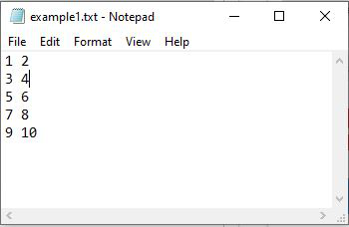
Downloading and parsing data
The following 'example1.txt' text file is considered in this example.
import numpy as np
# Text file data converted to integer data type
d = np.loadtxt("example1.txt", dtype=int)
print(d)
Output:
      [[ 1 2]
      [ 3 4]
      [ 5 6]
      [ 7 8]
      [ 9 10]]
9/4/2026

Slide 92
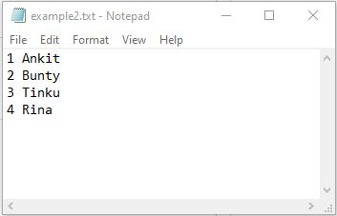
Downloading and parsing data
Importing text file into NumPy array by skipping first row
import numpy as np
# skipping first row and converting file data to string
d = np.loadtxt("example2.txt", skiprows=1, dtype='str')
print(d)
Output:
        [['2' 'Bunty']
        ['3' 'Tinku']
        ['4' 'Rina']]
9/4/2026

Slide 93
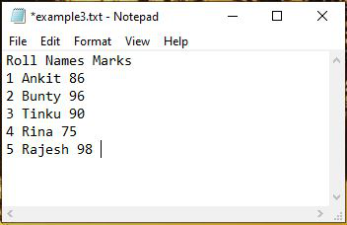
Downloading and parsing data
Importing only the first column(Names) of text file into numpy arrays
  import numpy as np
  # only column1 data is imported into numpy
  # array from text file
  d = np.loadtxt("example3.txt", usecols=1, skiprows=1, dtype='str')
  for each in d:
  print(each)
Output: Ankit
Bunty
Tinku
Rina
Rajesh
9/4/2026

Slide 94
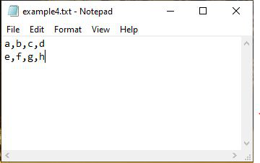
Downloading and parsing data
numpy.genfromtxt() is a more flexible function that can handle missing data, non-numeric data, and more complex file formats.
Importing Data with np.genfromtxt() in NumPy
  import numpy as np
  d = np.genfromtxt("example4.txt", dtype=str, encoding=None, delimiter=",")
  print(d)
Output:
[['a' 'b' 'c' 'd']
['e' 'f' 'g' 'h']]
9/4/2026

Slide 95
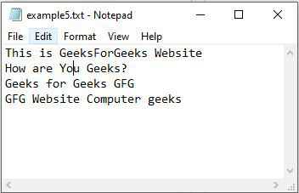
Downloading and parsing data
Importing text file into numpy arrays by skipping last row
import numpy as np
# skipping last line in the file
d = np.genfromtxt("example5.txt", dtype=str, encoding=None, skip_footer=1)
print(d)
Output:
[['This' 'is' 'GeeksForGeeks' 'Website']
['How' 'are' 'You' 'Geeks?']
['Geeks' 'for' 'Geeks' 'GFG']]
9/4/2026

Slide 96
Downloading and parsing data
1. If your data is available online, you would typically use a library like requests to download the file to your local system first.
    import requests
    url = "https://example.com/data.csv" # Replace with your data URL
    response = requests.get(url)
    with open("local_data.csv", "wb") as f:
    f.write(response.content)
9/4/2026

Slide 97
Downloading and parsing data
2. Parsing Data into a NumPy Array:
  import numpy as np
  # Assuming 'local_data.csv' contains comma-separated numerical data
  data = np.loadtxt("local_data.csv", delimiter=",")
  print(data)
  3. Handling Specific Data Types and Parsing Logic:
  Specifying dtype: If you know the expected data types, you can explicitly define them.
  Skipping rows/columns: You can skip header rows or specific columns if needed.
9/4/2026

Slide 98
NumPyData types
strings - used to represent text data, the text is given under quote marks. e.g. "ABCD"
integer - used to represent integer numbers. e.g. -1, -2, -3
float - used to represent real numbers. e.g. 1.2, 42.42
boolean - used to represent True or False.
complex - used to represent complex numbers. e.g. 1.0 + 2.0j, 1.5 + 2.5j
9/4/2026

Slide 99
NumPyData types
Below is a list of all data types in NumPy and the characters used to represent them.
      i - integer
      b - boolean
      u - unsigned integer
      f - float
      c - complex float
      m - timedelta
      M - datetime
      O - object
      S - string
      U - unicode string
      V - fixed chunk of memory for other type ( void )
9/4/2026

Slide 100
Check Data Type of a NumPy Array
import numpy as np
# create an array of integers
array1 = np.array([2, 4, 6])
# check the data type of array1
print(array1.dtype)
# Output: int64
dtype attribute is to check the data type of the array
9/4/2026

Slide 101
Creating NumPy Arrays With a Defined Data Type
we can create an array with a defined data type by passing the dtype parameter while calling the np.array() function.
import numpy as np
# create an array of unsigned 16-bit integers
array1 = np.array([2, 4, 6], dtype='uint16')
# create an array of 32-bit floating-point numbers
array2 = np.array([1.2, 2.3, 3.4], dtype='float32')
# create an array of 64-bit complex numbers
array3 = np.array([1+2j, 2+3j, 3+4j], dtype='complex64')
# print the arrays and their data types
print(array1, array1.dtype)
print(array2, array2.dtype)
print(array3, array3.dtype)
import numpy as np
# create an array of 32-bit integers
array1 = np.array([1, 3, 7], dtype='int32')
print(array1, array1.dtype)
Output: [1 3 7] int32
9/4/2026

Slide 102
NumPy Type Conversion
we can convert the data type of an array using the astype() method
        import numpy as np
        # create an array of integers
        int_array = np.array([1, 3, 5, 7])
        # convert data type of int_array to float
        float_array = int_array.astype('float')
        # print the arrays and their data types
        print(int_array, int_array.dtype)
        print(float_array, float_array.dtype)
        Output:
        [1 3 5 7] int64
        [1. 3. 5. 7.] float64
9/4/2026

Slide 103
Array Attribute
In NumPy, attributes are properties of NumPy arrays that provide information about the array's shape, size, data type, dimension, and so on.
commonly used NumPy attributes:
Attributes | Description
ndim | returns number of dimension of the array
size | returns number of elements in the array
dtype | returns data type of elements in the array
shape | returns the size of the array in each dimension.
itemsize | returns the size (in bytes) of each elements in the array
data | returns the buffer containing actual elements of the array in memory
9/4/2026

Slide 104
Array Attribute – Sample Program
import numpy as np
# create a 2-D array
array1 = np.array([[2, 4, 6],
[1, 3, 5]])
# check the dimension of array1
print(array1.ndim)
# Output: 2
import numpy as np
array1 = np.array([[1, 2, 3],
[6, 7, 8]])
# return total number of elements in array1
print(array1.size)
# Output: 6
9/4/2026

Slide 105
Matplotlib
Matplotlib is a low level graph plotting library in python that serves as a visualization utility.Matplotlib was created by John D. Hunter.
Matplotlib is open source and we can use it freely.
Matplotlib is mostly written in python, a few segments are written in C, Objective-C and Javascript for Platform compatibility.
C:\Users\Your Name>pip install matplotlib
import matplotlib
Most of the Matplotlib utilities lies under the pyplot submodule, and are usually imported under the plt alias: import matplotlib.pyplot as plt
9/4/2026

Slide 106
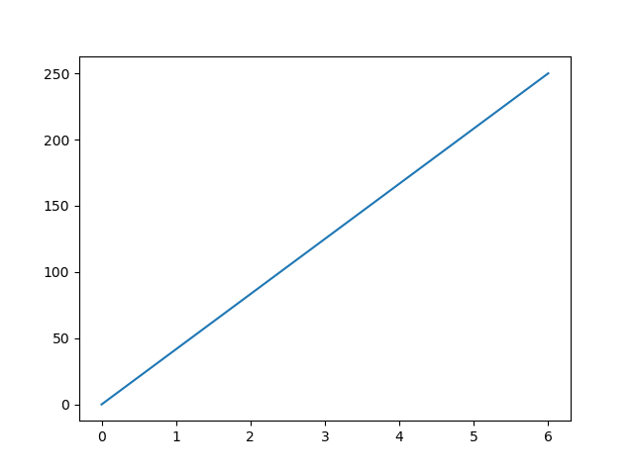
Matplotlib
  import matplotlib.pyplot as plt
  import numpy as np
  xpoints = np.array([0, 6])
  ypoints = np.array([0, 250])
  plt.plot(xpoints, ypoints)
  plt.show()
9/4/2026

Slide 107

Matplotlib - Plotting x and y points
The plot() function is used to draw points (markers) in a diagram.
By default, the plot() function draws a line from point to point.
  Parameter 1 is an array containing the points on the x-axis.
  Parameter 2 is an array containing the points on the y-axis.
import matplotlib.pyplot as plt
import numpy as np
xpoints = np.array([1, 8])
ypoints = np.array([3, 10])
plt.plot(xpoints, ypoints)
plt.show()
9/4/2026

Slide 108
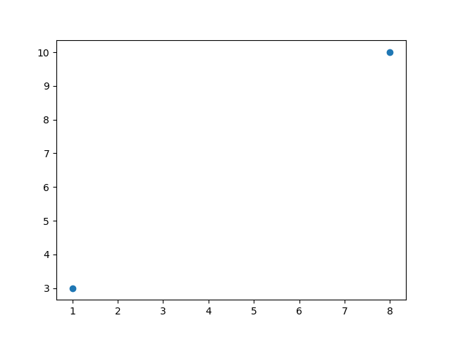
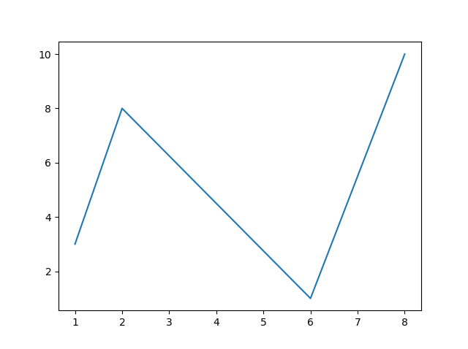
Matplotlib - Plotting without line and multiple points
import matplotlib.pyplot as plt
import numpy as np
xpoints = np.array([1, 8])
ypoints = np.array([3, 10])
plt.plot(xpoints, ypoints, 'o')
plt.show()
import matplotlib.pyplot as plt
import numpy as np
xpoints = np.array([1, 2, 6, 8])
ypoints = np.array([3, 8, 1, 10])
plt.plot(xpoints, ypoints)
plt.show()
9/4/2026

Slide 109
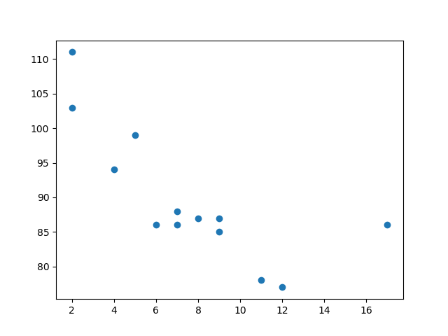
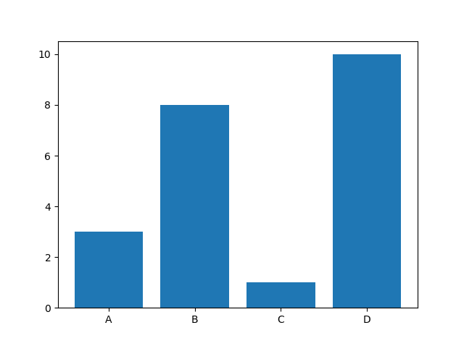
Scatter Plots and Bars
import matplotlib.pyplot as plt
import numpy as np
x = np.array([5,7,8,7,2,17,2,9,4,11,12,9,6])
y = np.array([99,86,87,88,111,86,103,87,94,78,77,85,86])
plt.scatter(x, y)
plt.show()
import matplotlib.pyplot as plt
import numpy as np
x = np.array(["A", "B", "C", "D"])
y = np.array([3, 8, 1, 10])
plt.bar(x,y)
plt.show()
9/4/2026

Slide 110
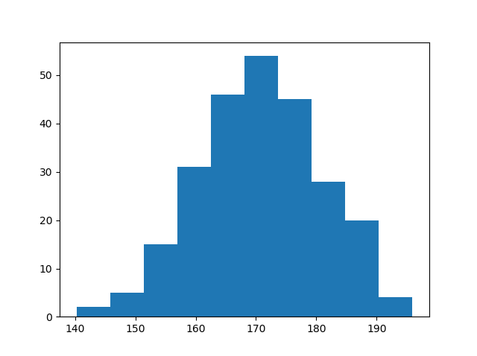
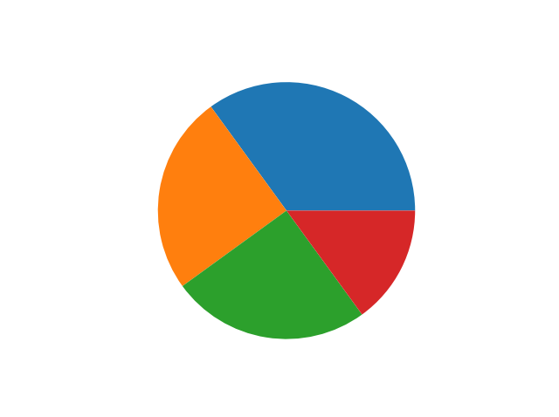
Histograms and Pie Charts
import matplotlib.pyplot as plt
import numpy as np
x = np.random.normal(170, 10, 250)
plt.hist(x)
plt.show()
import matplotlib.pyplot as plt
import numpy as np
y = np.array([35, 25, 25, 15])
plt.pie(y)
plt.show()
9/4/2026

